Slide 1

ONLINE EDUCATION
Learn, Improve, and Develop

Slide 2

GETTING STARTED
In this presentation we would produce a recommendation and some instructions of how we can improve the online education that depends on the information technology as a base of the process to get the main goal that is the world plan these days to get an effective online environment to enable students to obtain their suitable education.
We have looked at the experiment of using online studying during the period of COVID-19 to see what we got and what is the problems we faced to improve the infrastructure of the online education environment to get online education effective and efficient way.
To see where we are in this topic, we asked users (students) about their experiment of the online infrastructure in the period of COVID-19 that to get involve the user in the development process and know what is the user experience about online studying, we have done that by preparing multiple questions that related to our objective and used the responses to have a starting point.

Slide 3
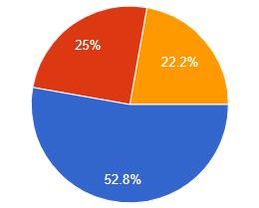
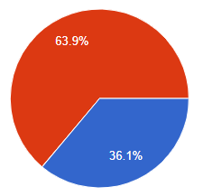
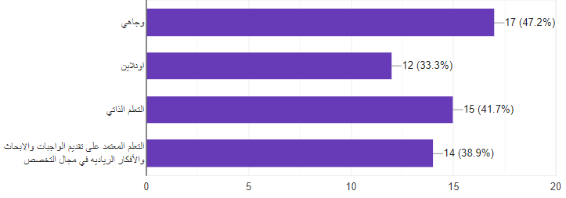


PLAN
After our survey, which included a large group of students from all over Jordan, we devised a set of tips that will help in developing the educational system.
ما هو نظام التعلم الذي تود ان تستخدمه في مسيرتك الأكاديمية؟
ما هو رأيك في النظرة المستقبلية للتوجه للتعلم عن بعد بشكل كامل؟
ما هي طرق التعلم التي تمكن من فهم التخصص بطريقه افضل؟
The questionnaire survey link: https://forms.gle/7CKXTvjEYijACR3D8

Slide 4

Society’s view of e-learning
E-learning was rejected by the local community as a result of the sudden change in social habits, which has always been based on face-to-face learning in universities, and now to change this idea needs time and make permanent and continuous improvements in e-learning systems that must be able to provide continuous guidance to the student in a way The student does not need a technical background in computers or dealing with towers, enough to be an easy and smooth gateway to involve into the e-learning process.

Slide 5


How to learn in E-learning?
It is obvious that online education has different characteristics than face-to-face education, and this leads to different methods that the student must take into account while dealing with the material in its digital form, and statistics show that the student prefers self-education that depends on research and self-work, to merge two types of educations in an efficient way, we need to improve the philosophy of education that is based on self-study and that makes e-learning more simple than the traditional way of teaching.

Slide 6

Courses material
To reach efficient e-learning that contains all academic standards, some modifications must be made to the study materials. We found from the statistics that everyone agreed that there is a relatively large free time in the case of using e-learning. Therefore, we recommend developing the study materials so that they rely more on research and practical application and not on memorization. Only because research, conclusion, and practical application need time, which we will get as a result of saving time in e-learning. This time can be used in studying materials through practical application, which adds pleasure to learning and does not be boring.

Slide 7

Internet connection
The widespread idea is “In cities, the Internet is strong around the clock.” Statistics have shown that this idea is not correct, and the problem of the Internet is widespread in cities, and remote villages so many students faced a big problem in online education because of the internet in their residential area, to reduce the impact of this problem we suggest using the learning system in offline lectures by recorded the lectures and then upload them on the system by following this method, you will contribute to reducing the time that the student needs to connect to the network.

Slide 8

Technical point of view
In light of the wide technological development these days, which is evident through the statistics, those modern technological means are sufficient to provide good e-education, which has achieved customer satisfaction, as Microsoft Teams program was taken 5 out of 5, but through our endeavor to provide a comprehensive electronic environment for all operations, we recommend providing A complete educational system that contains all the requirements of teaching, communication, interaction and presentation of exams, all of the procedures as one component that connected with each other which will reduce the conflict of going from system to another system.

Slide 9

Thank You!
Hesham Mousa
Ahmad Ataya
Abdallah Abu Arab

